Slide 1

Level Up Your Java Code with Spring Framework
Enhancing Java Development through Spring Framework
D. Kekelidze, CERN
Pori Spring Campus, May 2025
Notes:
The Spring Framework is a powerful tool for Java developers that simplifies the development of enterprise applications. In this presentation, we will explore the core concepts, features, and practical applications of Spring to enhance your Java coding experience.

Slide 2

ASYNC Follow up

Slide 3

Topics to be Covered
Introduction to Spring Framework
Core Concepts of Spring Framework
Spring MVC for Web Applications
Spring Security for Application Protection
Exploring Spring Security Pre-Authorization Filters and AOP Proxy Concepts
Spring Data Layer Integration
Transaction Management in Spring
Spring Boot for Rapid Development
Notes:
We will begin with an introduction to the Spring Framework, its purpose, and advantages. Next, we will delve into core concepts like Dependency Injection and Inversion of Control. We'll also cover Spring MVC, Security, Data Layer integration, Transaction Management, and conclude with Spring Boot for rapid development.

Slide 4
Introduction to Spring Framework
Notes:
The Spring Framework is designed to address the complexities of Java application development by providing comprehensive infrastructure support. It aims to simplify coding practices and enhance productivity for developers.

Slide 5
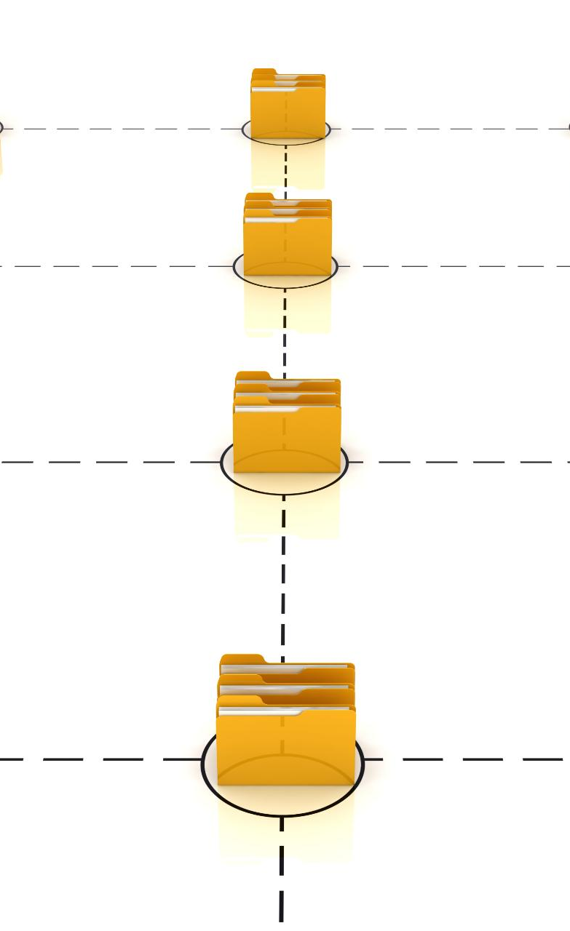
Problems Spring is intended to solve
Tight Coupling Issue
Spring tackles the problem of tight coupling in Java applications, allowing for more flexibility and easier maintenance.
Testing Difficulties
Spring helps overcome testing difficulties in Java development by promoting dependency injection and easier testability.
Enhanced Modularity
Spring's modular architecture allows developers to build applications in a more structured and maintainable manner.
Notes:
Spring addresses several challenges in Java development, such as tight coupling, difficulties in testing, and the complexity of Java EE applications. It promotes a more modular approach to application design.

Slide 6

Major Companies Using Spring Framework
Netflix utilizes Spring for its microservices architecture.
Amazon relies on Spring for building scalable applications.
eBay employs Spring to enhance its e-commerce platform.
Accenture utilizes Spring for agile software development.
LinkedIn incorporates Spring for managing data and services.
Notes:
Many big companies leverage the Spring Framework for its powerful capabilities in building scalable and maintainable applications. For instance, Netflix uses it extensively for their microservices architecture, allowing them to manage complex systems effectively. Similarly, Amazon and eBay utilize Spring to enhance their services, demonstrating the framework's flexibility and reliability in large-scale environments.

Slide 7

Overview of Spring Framework features
Dependency Injection
Spring MVC Framework
Spring Data
Notes:
The Spring Framework includes features like Dependency Injection, Aspect-Oriented Programming, Spring MVC for web applications, and Spring Data for database handling. These features make it a robust choice for Java development.

Slide 8
Core Concepts of Spring Framework
Notes:
Understanding the core concepts of Spring is essential for effective application development. Concepts like Dependency Injection and Inversion of Control form the backbone of the framework.

Slide 9
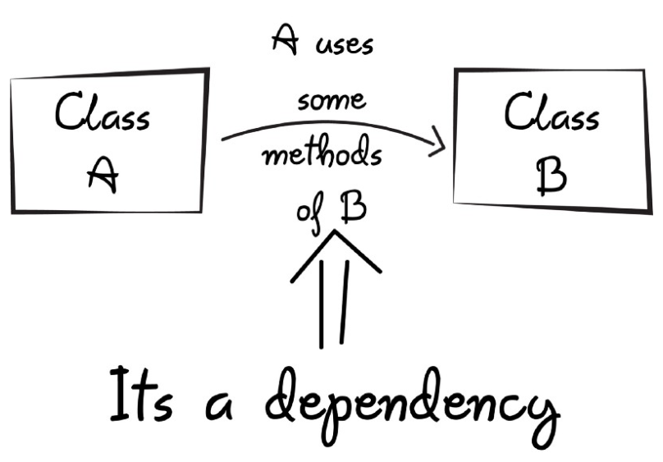
Dependency Injection
Design Pattern Overview
Dependency Injection is a design pattern that promotes Inversion of Control, enhancing code structure and flexibility.
Efficient Dependency Management
DI allows for efficient management of object dependencies, leading to cleaner and more modular code.
Testing and Maintenance
Using DI simplifies testing and maintenance by allowing easy swapping of implementations and mocking dependencies.
Notes:
Dependency Injection (DI) is a design pattern used in Spring to achieve Inversion of Control. It allows for efficient management of dependencies, making code easier to test and maintain.

Slide 10
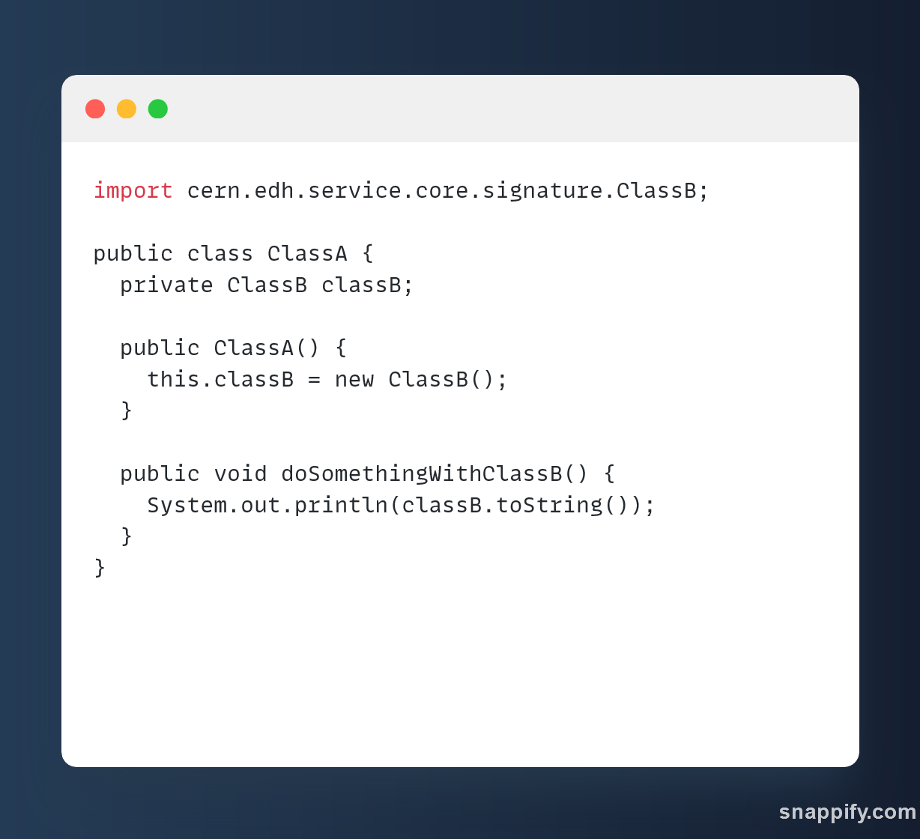
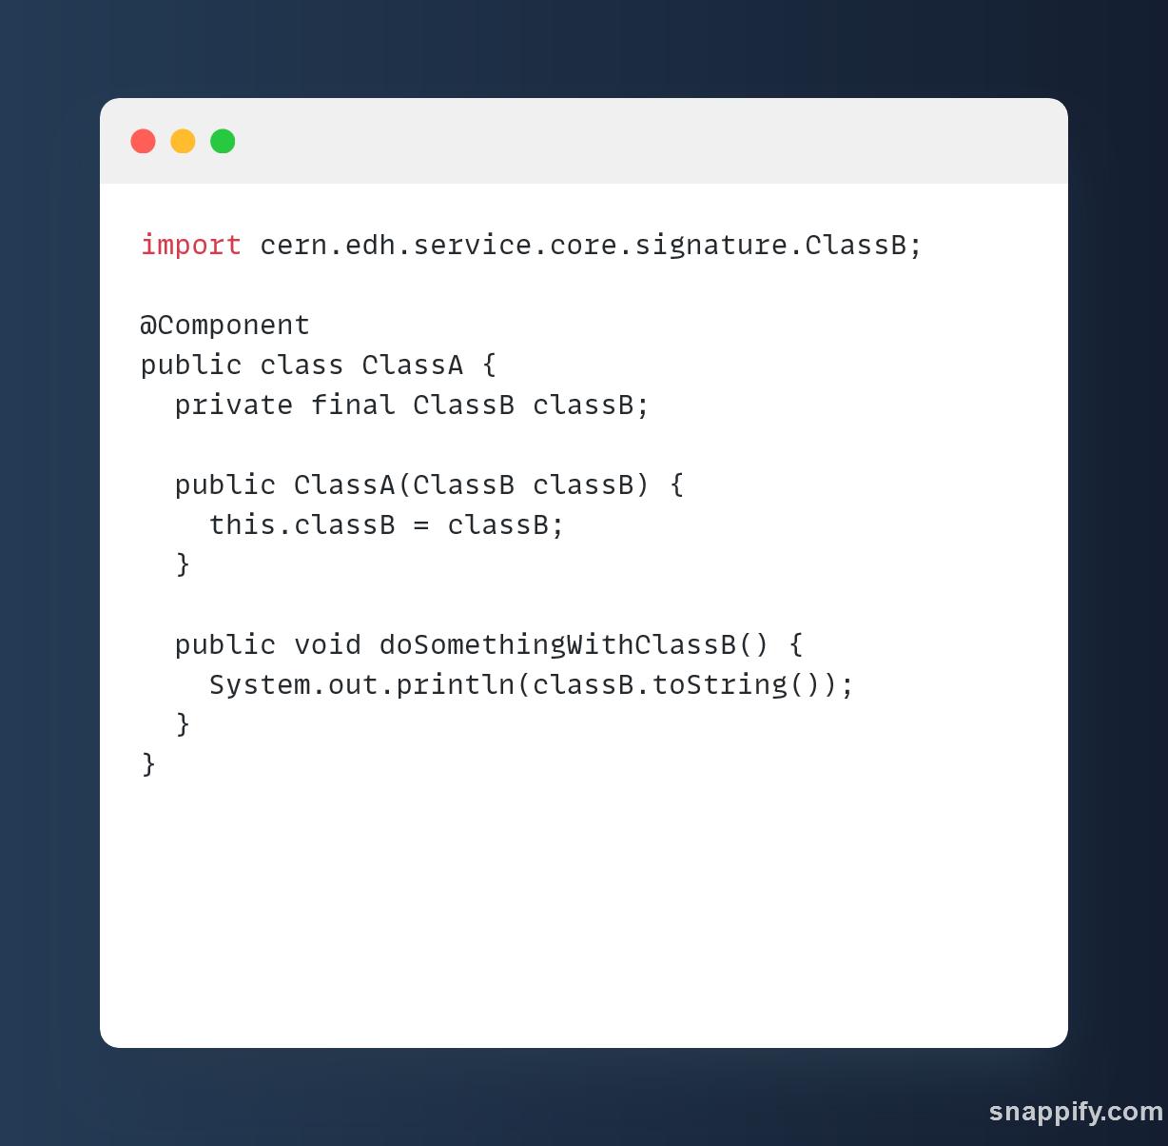

Slide 11

Inversion of Control
Core Concept
Inversion of Control refers to the delegation of object creation and management to a container or framework, instead of allowing the objects to manage their own lifecycle. This approach improves modularity and contributes to enhanced code maintainability.
Function of the Spring Container
The Spring container assumes the duty of overseeing object lifecycles and their dependencies. As a result, developers are freed from the task of manual instantiation, resulting in cleaner code and improved maintainability.
Notes:
Inversion of Control (IoC) is a fundamental principle in Spring. It transfers the control of object creation and management to the Spring container, freeing developers from manual instantiation.

Slide 12
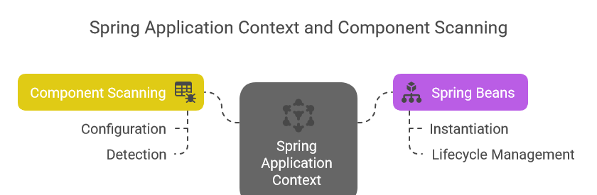
Spring Application Context
It’s a container that holds classes intended to be used for dependency injection (Spring beans) through component scanning.
Notes:
The Application Context is an extension of the BeanFactory and provides additional features, such as event propagation and internationalization. It serves as the backbone of the Spring Framework.

Slide 13
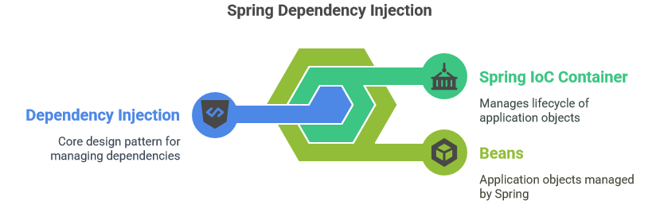
Component Scanning
This feature detects classes and registers them in the application context based on the provided configuration, simplifying the setup of Spring applications by removing the need for manual registration.

Slide 14
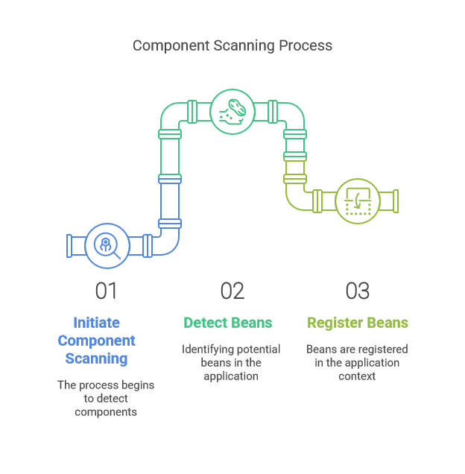
Component Scan Configuration
Core Principle
With component scanning enabled, Spring searches specified packages for classes marked with
@Component
@Service
@Repository
@Controller
This signifies that these classes should be managed by the Spring container. Upon detection, Spring registers them as beans for dependency injection.
Flexible Configuration Options
Spring allows configuration through XML or Java annotations, offering developers versatile setup choices.
Notes:
Spring uses component scanning to automatically detect and register beans in the application context. Configuration can be done using XML or Java annotations, making setup flexible and convenient.

Slide 15

Spring Beans and Their Lifecycle
Definition of Spring Beans
Spring beans are (Java) objects managed by the Spring container, essential for dependency injection and resource management.
Lifecycle Phases
The lifecycle of Spring beans includes instantiation, initialization, usage, and destruction, crucial for effective resource management.
Resource Management
Understanding the lifecycle helps manage resources effectively, ensuring optimal performance and memory usage in applications.
Notes:
Every object managed by the Spring container is called a Spring bean. Understanding the lifecycle of these beans, from instantiation to destruction, is key to managing resources effectively.

Slide 16

Spring framework for Web Applications
Notes:
Spring MVC is a powerful framework for building web applications in Java. It follows the Model-View-Controller architecture, promoting a clean separation of concerns in the application design.

Slide 17

Introducing Spring MVC: A Framework for Web Development
Spring MVC is ideal for building scalable web applications.
It supports RESTful web services.
Integrates seamlessly with other Spring modules.
Notes:
Spring MVC proves to be exceptionally useful in real-life scenarios where developers need to create scalable web applications. Its robust architecture facilitates the development of complex user interfaces while supporting RESTful services, which are essential for modern web apps. Additionally, Spring MVC integrates well with other Spring modules, allowing for comprehensive application functionality and improved overall performance.

Slide 18

Model-View-Controller architecture
Three interconnected components of MVC:
The Model represents the data and business logic.
The View displays the user interface and the presentation layer.
The Controller manages user input and updates the Model and View.
Notes:
The Model-View-Controller (MVC) architecture is a powerful design pattern used in software development. It divides an application into three main components: the Model, which handles data and business logic; the View, which is responsible for displaying the user interface; and the Controller, which processes user input and interacts with both the Model and View. This separation promotes modularity and makes it easier to manage complex applications.

Slide 19
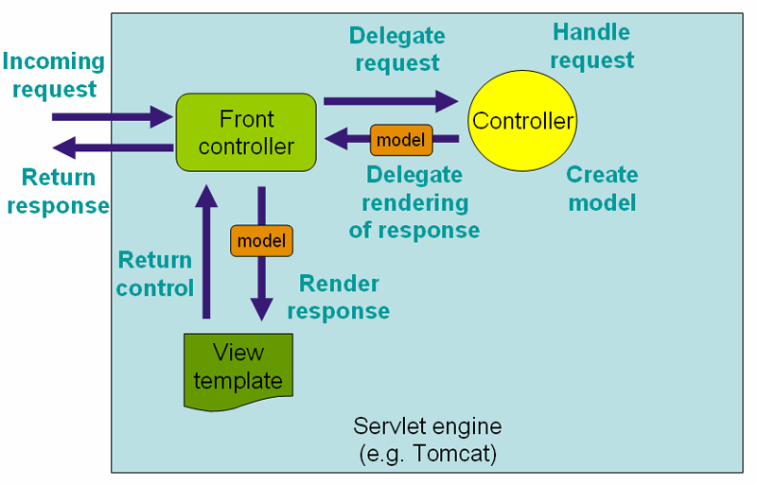

Slide 20
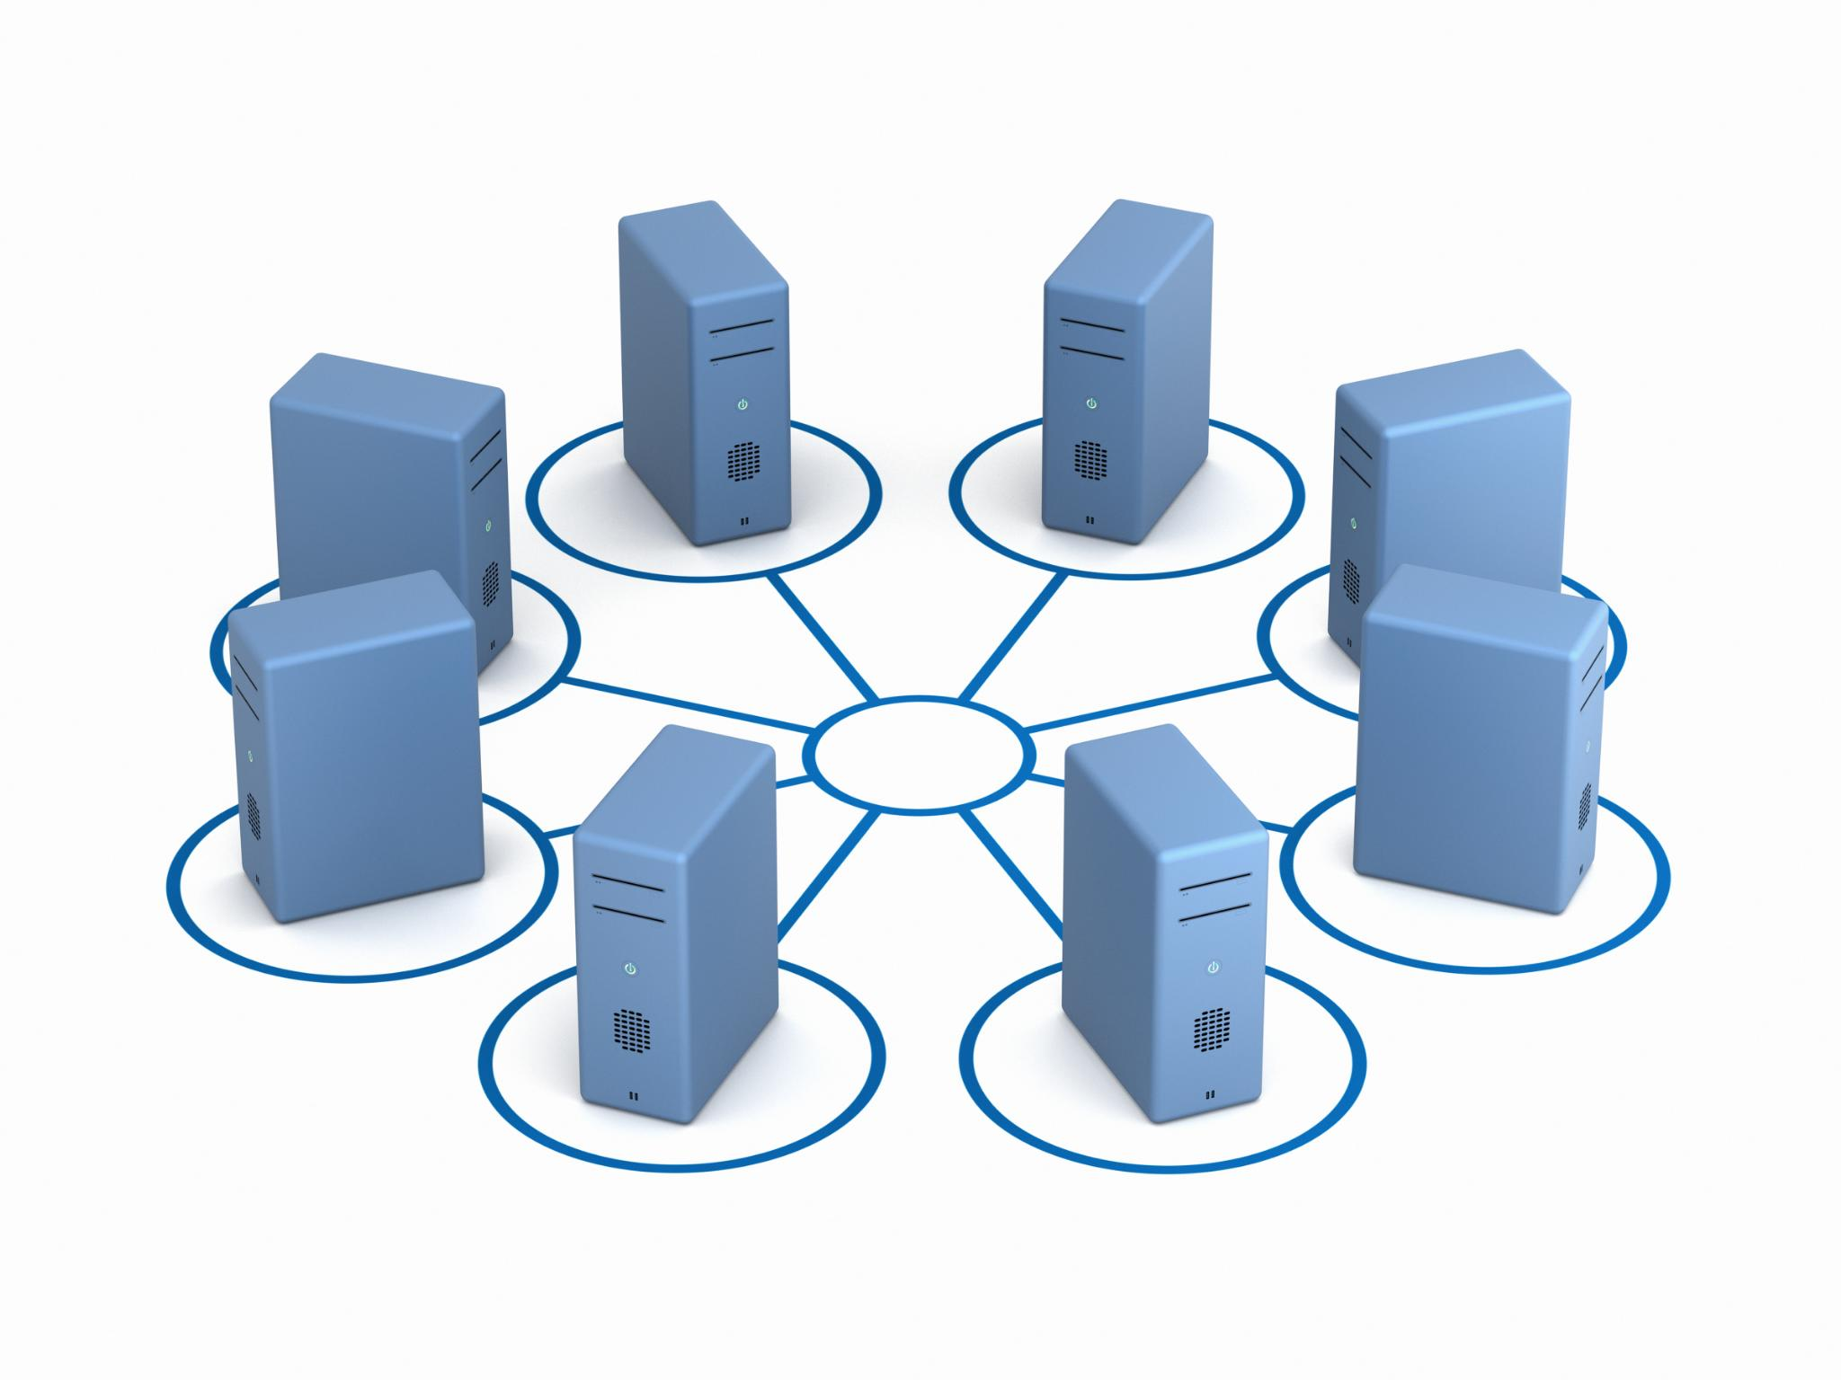
Setting up Spring MVC
Configuring Spring MVC
Improving the current configuration to incorporate support for Spring MVC.
Establishing View Resolvers
View resolvers play a crucial role in Spring MVC by enabling developers to display the appropriate user interface following the handling of requests.
Creating View, Model, and Controller
Develop all three components to showcase the MVC framework in operation.
Notes:
Setting up Spring MVC involves configuring the DispatcherServlet and setting up view resolvers. This foundational setup enables developers to create robust web applications with ease.

Slide 21
Spring Security for Application Protection
Notes:
Spring Security provides comprehensive security features to protect applications. This section will cover authentication, authorization, and how to secure applications effectively.

Slide 22

Security features in Spring
Authentication
Spring Security provides robust authentication mechanisms to verify users, ensuring that only authorized individuals can access applications.
Access Control
Access control features allow developers to define who can access certain resources, ensuring proper permissions are enforced.
Protection Against Vulnerabilities
Spring Security helps protect applications against common security vulnerabilities, ensuring a secure environment by default.
Notes:
Spring Security offers features such as authentication, access control, and protection against common security vulnerabilities. These features help ensure that applications are secure by default.

Slide 23
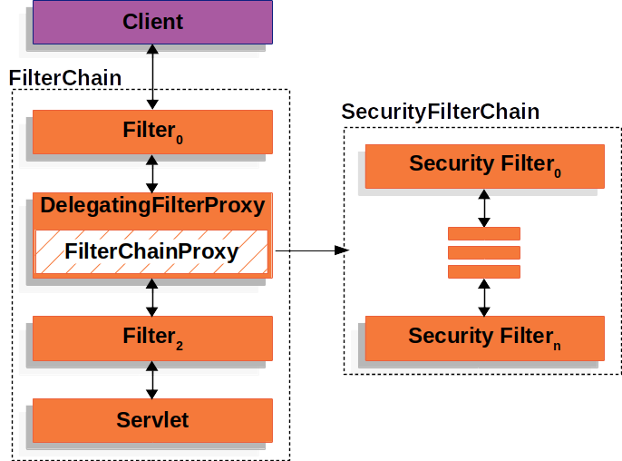
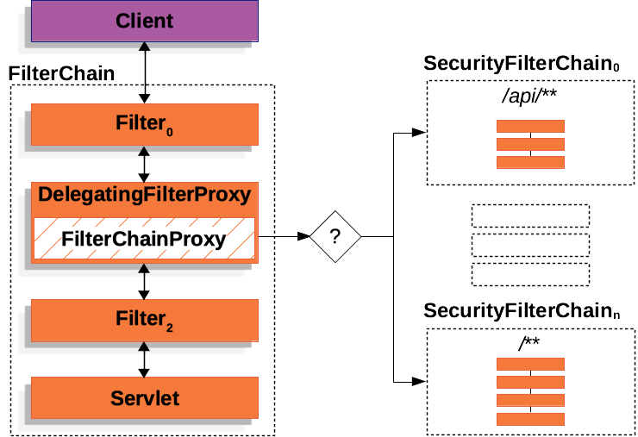
Understanding spring security internals
Notes:
The filter chain is a series of filters that process incoming requests and outgoing responses. Each filter in the chain performs a specific security-related task, such as authentication, authorization, or logging. When a request is received, it passes through the filter chain, where each filter can either allow the request to proceed, modify it, or block it based on the security rules defined.
In Spring Security, the filter chain is highly configurable, allowing developers to customize the order and behavior of filters to meet their specific security requirements. This flexibility ensures that applications can enforce robust security policies while maintaining performance and scalability.

Slide 24

Practical examples with code
Configure Spring Security
Learn how to configure Spring Security features in applications through clear coding examples and explanations.
Real-World Scenarios
Explore real-world scenarios that demonstrate the importance of securing applications using Spring Security effectively.
Best Practices
Understand best practices for using Spring Security to safeguard your applications and protect sensitive data.
Notes:
We will provide practical coding examples to illustrate how to implement Spring Security features, helping to secure applications with real-world scenarios.

Slide 25
Exploring method level Spring Security and AOP Proxy Concepts
Notes:
In this section, we will explore advanced Spring Security concepts, including Pre-Authorization Filters and Aspect-Oriented Programming (AOP) proxies, to enhance application security.

Slide 26

Understanding method Authorization in Spring Security
Purpose of Pre-Authorization Filters
Pre-authorization filters enforce security checks to ensure users have permissions before executing specific actions in the code.
By validating permissions beforehand, pre-authorization filters mitigate potential unauthorized actions in applications.
Access rules
Defining access rules is essential to determine user permissions for various methods or resources. It ensures that only authorized users can access sensitive data.
Notes:
Pre-Authorization Filters in Spring Security allow you to enforce security checks before an action is performed. This ensures that users have the necessary permissions to execute specific actions.

Slide 27
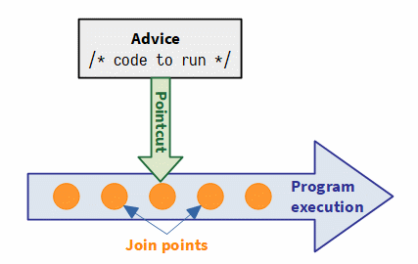
Concepts of Aspect-Oriented Programming (AOP) in Spring
Definition of AOP
Aspect-Oriented Programming (AOP) is a programming paradigm that enables the separation of cross-cutting concerns, improving code modularity.
Cross-Cutting Concerns
AOP allows developers to manage cross-cutting concerns like logging and security independently from business logic, enhancing maintainability.
Enhancing Modularity
By using AOP, developers can create more modular applications, making it easier to manage and evolve code over time.
Notes:
Aspect-Oriented Programming (AOP) allows developers to define cross-cutting concerns, such as logging and security, separately from the main business logic, enhancing modularity.

Slide 28
Spring Data Layer Integration
Notes:
Spring Data simplifies database interactions and provides a consistent programming model for data access. This section covers how to integrate Spring Data into applications.

Slide 29

Working with Spring Data JPA
Abstraction Layer
Spring Data JPA offers an abstraction layer over JPA, streamlining the implementation of data access functionality.
Simplified CRUD Operations
The framework simplifies CRUD operations, making it easier for developers to manage data in applications.
Support for Complex Queries
Spring Data JPA supports complex queries, allowing developers to efficiently retrieve and manipulate data.
Object-Relational Mapping (ORM)
ORM allows developers to interact with databases using Java objects, streamlining the development process and improving productivity.
Notes:
Spring Data JPA provides an abstraction layer over JPA, making it easier to implement data access layers. It simplifies CRUD operations and supports complex queries.

Slide 30
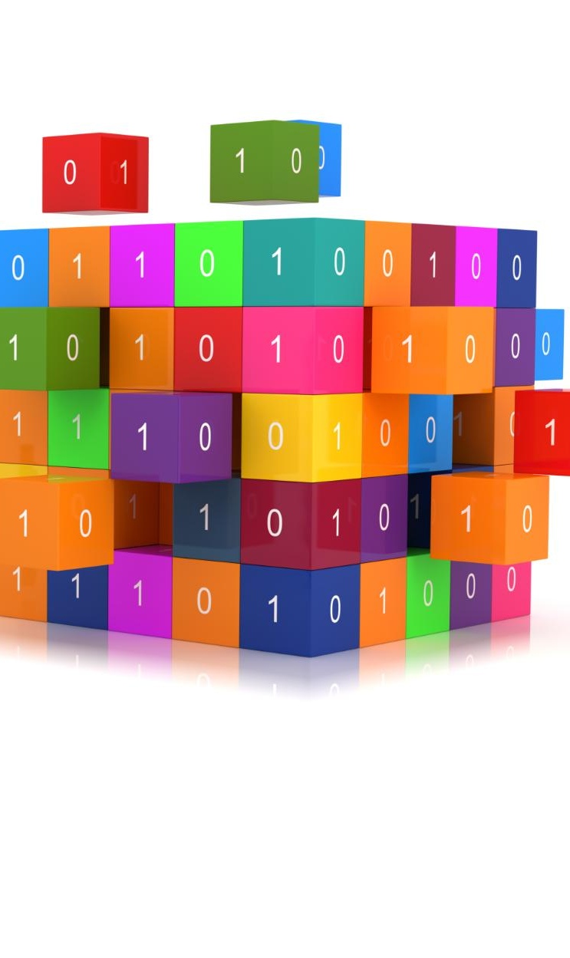
Practical examples with code
Spring Data JPA Overview
Integrate Spring Data JPA in our Java application, making it easy to implement CRUD operations.
Database Operations
Practical coding examples will demonstrate how to perform various database operations using Spring Data JPA effectively.
Framework Benefits
The examples will illustrate the simplicity and power of Spring Data JPA, enhancing productivity in Java development.
Notes:
We will present practical coding examples that showcase how to use Spring Data JPA for database operations, illustrating the simplicity and power of the framework.

Slide 31
Spring Boot for Rapid Development
Notes:
Spring Boot is a powerful extension of the Spring Framework that offers rapid application development capabilities. This section will discuss its benefits and applicability.

Slide 32

Benefits of using Spring Boot
Reduced Configuration Overhead
Spring Boot eliminates much of the boilerplate configuration needed in traditional Spring applications, making development faster and easier.
Auto-Configuration Feature
Spring Boot provides auto-configuration, which automatically configures your application based on the included libraries and settings.
Embedded Servers
Spring Boot includes embedded servers that allow you to run applications without needing an external server setup, simplifying development.
Simplified Project Setup
Spring Boot simplifies project setup, allowing developers to create and start applications quickly with minimal configurations.
Notes:
Spring Boot eliminates much of the boilerplate configuration required in traditional Spring applications. It offers features like auto-configuration, embedded servers, and a simplified project setup.

Slide 33

Applicability of Spring Boot vs plain Spring Framework
Spring Boot for Microservices
Spring Boot is designed for smaller applications, facilitating rapid development and deployment with minimal configuration.
Rapid Development Scenarios
Spring Boot significantly speeds up application development, allowing developers to focus on business logic rather than configuration.
Plain Spring Framework Control
The plain Spring Framework provides more control and flexibility, making it suitable for complex enterprise applications.
Notes:
Spring Boot is ideal for microservices and rapid development scenarios, while the plain Spring Framework is better suited for complex applications requiring fine-grained control.

Slide 34

Practical examples with code
Introduction to Spring Boot
Spring Boot simplifies the development process, enabling developers to create applications quickly with minimal configuration.
Ease of Use
Spring Boot's user-friendly setup and built-in functionalities make it a popular choice for developers aiming for efficiency.
Notes:
We will conclude with practical coding examples that illustrate how to leverage Spring Boot for rapid development, showcasing its ease of use and effectiveness.

Slide 35
Conclusion
Enhancing Java Development
The Spring Framework and Spring Boot provide essential tools that enhance Java application development significantly.
Building Secure Applications
These frameworks help developers create secure applications with built-in security features and best practices.
Maintainable and Scalable Solutions
Spring tools promote maintainability and scalability, ensuring applications can grow with user demands.
Notes:
The Spring Framework and Spring Boot significantly enhance Java development by providing powerful tools for building secure, maintainable, and scalable applications. The concepts and examples covered in this presentation will help you level up your Java coding skills.

Slide 36
Transaction Management in Spring
Notes:
Transaction management is crucial for ensuring data consistency and integrity. This section covers how Spring handles transactions, including rollback and commit mechanisms.

Slide 37

Understanding DB Transactions Vs. Spring Transactions
Traditional DB Transactions
Traditional database transactions ensure data integrity through ACID properties, providing a reliable way to handle data changes.
Spring Transaction Management
Spring's transaction management offers a flexible and declarative approach to handle transactions, simplifying application development.
Data Integrity Importance
Both transaction types are crucial for maintaining data integrity, which is essential for effective application performance.
Notes:
Understanding the difference between traditional DB transactions and Spring's transaction management is essential for effective application development and ensuring data integrity.

Slide 38

Transaction Rollback and Commit Mechanisms in Spring
Simplified Transaction Management
Spring simplifies transaction management with a clear approach to rollbacks and commits, improving developer efficiency.
Declarative Transaction Boundaries
Developers can define transaction boundaries declaratively using annotations, making code cleaner and easier to manage.
Programmatic Transaction Management
Spring also allows for programmatic definition of transactions, providing flexibility for complex transaction scenarios.
Notes:
Spring provides a simplified approach to managing transaction rollbacks and commits, allowing developers to define transaction boundaries declaratively and programmatically.

Slide 39
Practical Examples of Transaction Management
Introduction to Transaction Management
Understanding transaction management is crucial for ensuring data integrity and consistency in applications.
Spring Framework Transactions
Spring provides powerful abstraction for managing transactions, simplifying the development process.
Coding Examples
We will demonstrate coding examples that show how to implement transaction management effectively in Spring.
Notes:
We will provide practical coding examples demonstrating how to manage transactions in Spring, highlighting the importance of effective transaction management in applications.

Slide 40

Unit Testing in Spring Framework
Unit tests verify individual components for expected behaviour.
Mocking allows isolation of classes like repositories and services during testing.
Effective unit tests improve code reliability and maintainability.
Integration tests complement unit tests by validating component interactions.
Notes:
Unit testing is crucial for ensuring that individual components of your Spring application function correctly. By using mocking, developers can isolate classes such as repositories and services, allowing for focused tests. Spring offers convenient annotations to facilitate testing, which helps improve code reliability. Alongside unit tests, integration tests are essential for validating how components work together within the application.

